Slide 1
Assignment 3 – Price Prediction
By Sriyaank Vadlamani

Slide 2

Review of EDA
Found that the price variable had very weak correlations with other numeric variables
Found relationship between the presence of crime and price
Found relationship between the room type and price
Found relationship between neighborhood and price

Slide 3


Since no numerical variables are highly correlated enough with price, I only have access to categorical variables
Thus, I will be using a decision tree to predict the price using the rpart library

Slide 4

What variables to Use?

Slide 5
Variable #1: Distances from POI
In EDA, I found the Distance from the nearest POI wasn't useful for predicting price since there was no correlation between the two variables.
However, some POIs are more desirable than others and some aren't ideal to be near.
For instance, getting an Airbnb near JFK airport isn't ideal since it's noisy and far from other tourist locations.
In my experience, people in New York tend to like Broadway shows, so the distance from Broadway may also have an impact.
Lets include distance from JFK and distance from Broadway in the model.

Slide 6
Variable #2: Presence of Crime
EDA showed no correlation between crime rate and price
EDA showed correlation between the presence of crime and price
Will add column that indicates if there is a recorded crime rate near the Airbnb

Slide 7
Additional Variables
EDA showed correlation between neighborhood and price
Too many neighborhoods for our decision tree
Will use neighborhood group instead
EDA showed correlation between room type and price, so will use it

Slide 8
Making decision trees

Slide 9
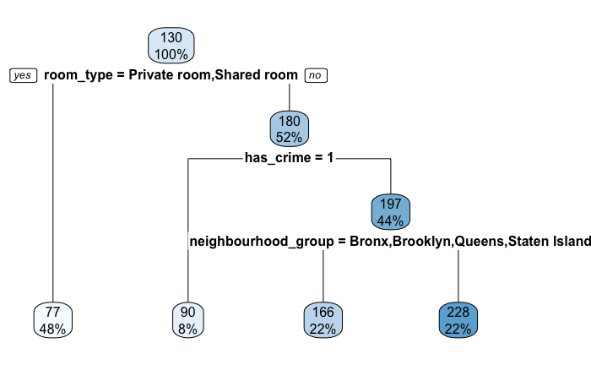
Test #1
Used all the variables mentioned to create the tree
This tree didn’t end up using the distance from POI variables
Only 4 leaf nodes. It could be better

Slide 10
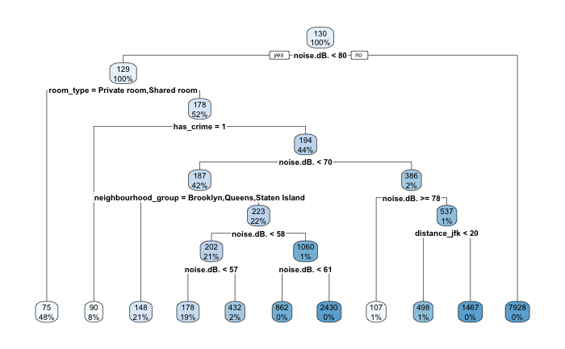
Test #2
Although none of the numerical variables correlated a lot with price, minimum nights, number of reviews, and noise(dB) correlated the most
Will try making decision tree that includes these
This has a lot of leaf nodes (11),
Some of the variables are unused, so will remove them.

Slide 11
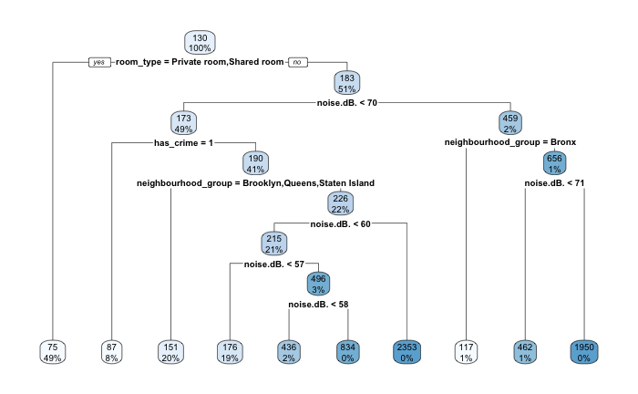
Test #3
This time, I created the tree using a random sample of 7700 rows (the size of the test dataset) so I can use the tree to predict the prices on the test dataset
I also only used the variables shown in the second decision tree
This ended up being the decision tree I went with
Was able to use this model to predict the prices in the test dataset

